Slide 1
Fennema‐Notestine C, Ozyurt I B, Clark C P, et al. Quantitative evaluation of automated skull‐stripping methods applied to contemporary and legacy images: Effects of diagnosis, bias correction, and slice location[J]. Human brain mapping, 2006, 27(2): 99-113.
This article compare with these 4 method to do skull-strip：
BET 3dIntracranial (AFNI) HWA BSE
’’HWA and BSE were more robust across diagnostic groups compared with 3dIntracranial and BET. With respect to specificity, BSE tended to perform best across all groups, whereas HWA was more sensitive than other methods.’’

Slide 2
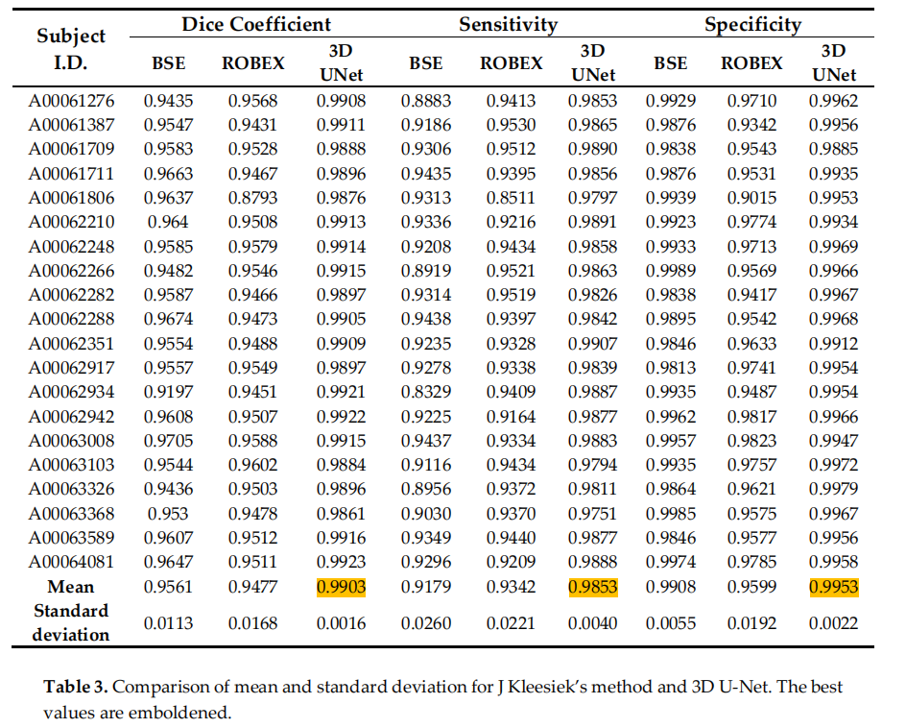
Hwang H, Rehman H Z U, Lee S. 3D U-Net for skull stripping in brain MRI[J]. Applied Sciences, 2019, 9(3): 569.
Evaluate 3D u-net network , compare with BSE, ROBEX, and Kleesiek’s method
Tips:
About 3D U-Net：
https://arxiv.org/abs/1606.06650
3D U-Net: Learning Dense Volumetric
Segmentation from Sparse Annotation

Slide 3
deepbrain: Extractor
https://github.com/iitzco/deepbrain/blob/master/README.md
Extractor runs a custom U-Net model trained on a variety of manual-verified skull-stripping datasets.
’’Why choose Extractor over others (e.g. BET FSL, ANTs, PINCRAM)?
1.Extractor is fast. It's CNN was implemented on Tensorflow and carefully designed to be as small as possible. < 2 second extraction on GPU or 20 second on i5 CPU
2.Running Extractor is easy. Don't need to provide any complicated parameters (like brain templates or prior probability masks), just with the brain MRI is enough.
3.Extractor is accurate. It does not fail in some cases where others (specially BET) fails.’’

Slide 4
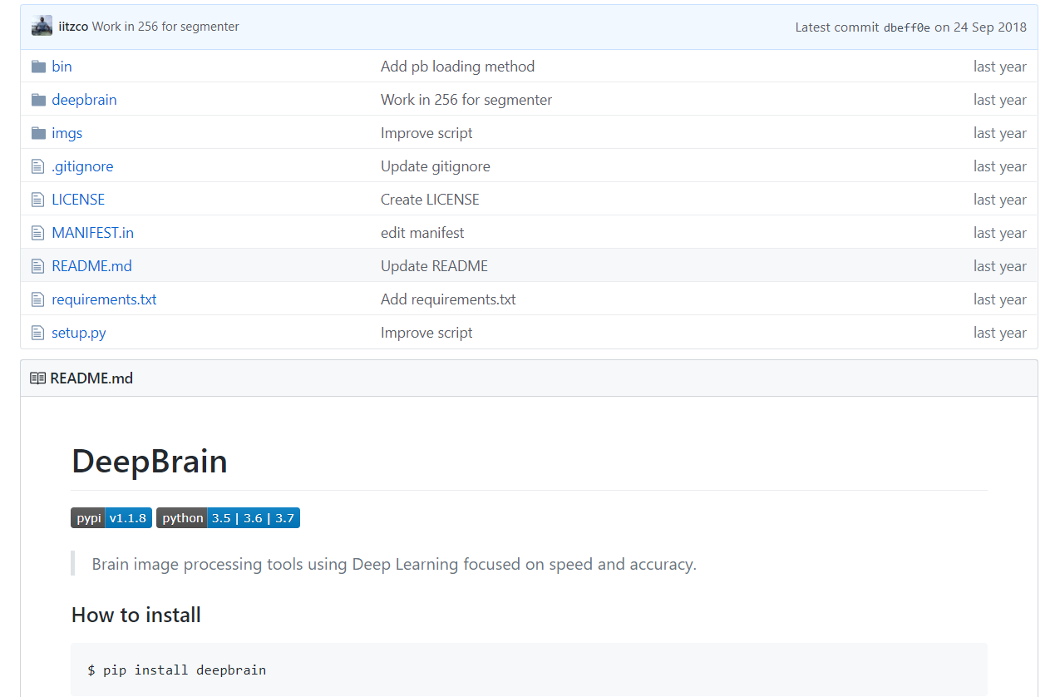

Slide 5
I think deepbrain is a very good benchmark.
It do not need to install AFNI or FSL
It performs well than other methods
It is easy to use (e.g. pip install deepbrain)
3D U-Net model is fashion
Their trouble is not hard for us to solve:
In my opinion, why Alex said deepbrain is not useful in some dataset is that they just train this model in 3 small dataset.
We can use data augmentation method or find new dataset to train it.
Moreover, we can rebuild their model frame if we have time
It is deliverable. It give us a good guidance that maybe we can also build a package and let others use pip to install it.

Slide 6
As for data-augmentation:
Traditional method (e.g. flip, noise, rotate, image contrast, precision)
GAN
MIT method ‘Data augmentation using learned transformations for one-shot medical image segmentation’(http://www.mit.edu/~adalca/files/papers/cvpr2019_brainstorm.pdf )
Find new dataset

Slide 7
robust
pure python

